Slide 1
Higher-level Language Comprehension and Conversation/Dialogue
BCS 501, Fall, 2011

Slide 2
Some Topics from Early Literature
Early results/influences:
Memory for Gist (B&F)
The turtles rested/beside/on the log and the fish swam beneath it/them
Gricean Maxims
indirect speech acts
metaphor, idioms
Inference
Frameworks:
Early AI Models (Schank & Abelson)
Construction integration (Text processing models Kintsch & Van Dijk)
Memory-based retrieval (McKoon & Ratcliff)
Bridging inferences (coherence)
Anaphoric: Beer/picnic supplies out of the trunk. The beer was warm.
Clark & Haviland (given-new)
Semantic (instruments)
The tourist took the picture with the camera. The scene was more beautiful than he remembered.
The tourist took the picture of the church. The camera was the best he had ever owned.
The tourist took the picture of the church. The scene was more beautiful than he remembered
The tourist used a camera
Causal inferences
Elaborative inferences:
Predictive inferences:
…hurled the (delicate) vase against the wall.

Slide 3
Where has all of this gone?
Anaphora:
It’s hard (inference)
Names versus pronouns
Centering (Grosz & Snider)
John saw Bill walking down the street. He/John said hello to him/Bill
Repeated name penalty
Accessibility/Activation Hierarchy (Gundel et al. 1993)
Null forms>pronouns>definite reference>that N> indefinite
Form specific (Kaiser)
It/that
Information structure
Topic/focus, given new and variants (Prince)
prosody
Causality and Inference
Discourse cohesion relations
Experimental Pragmatics
Implicature
QUD

Slide 4
Outline
Referential domains, affordances & definiteness
Chambers, Tanenhaus et al. (JML, 2002)
Pre-nominal adjectives
Scalar, color and material adjectives (Sedivy, 2003)
Two contrast vs one-contrast
Mention vs availability of referent
Scalar implicature
Logical vs pragmatic sum
Huang & Snedecker
Grodner et al.
Degen & Tanenhaus (Gumballs)
Prosody
Accent and information structure
Disfluency
Pitch accents
L+H* vs H* (contrastive focus)
Boundary tones (L vs H)
De-accenting

Slide 5
Definiteness and Referential Domains
Definite referring expressions assume a uniquely identifiable referent with respect to a circumscribed referential domain.
Hand me the (*an) empty martini glass.
Hand me an (*the) empty jar.
Notes:
Go through slide, then:
Given that interpretation takes place w/r to a circumscribed domain, How is the domain circumscribed. Classic view: language processing
is so fast it must rely on special purpose limited computations. What’s truly remarkable is how rapidly we idefine and interpret w/r to the relevant world

Slide 6
Chambers et al., JML, 2002
Are referential domains dynamically updated taking into account context-specific properties and actions?
Display - Chambers: Uniqueness
Big Can (potential target)
Small Can
.
(potential target)
Bowl (unique
competitor)
Cube (small OR big)
“
P
i
c
k
u
p
t
h
e
c
u
b
e
.
N
o
w
p
u
t
i
t
i
n
t
h
e
/
a
c
a
n
.
”
Notes:
Experiment 2 in the work that John talked about yesterday with anticipations and spatial prepositions (into, beside).

Slide 7
Chambers et al., JML, 2002
Referential domains are dynamically updated taking into account context-specific properties and actions
Display - Chambers: Uniqueness
Big Can (potential target)
Small Can
.
(potential target)
Bowl (unique
competitor)
Cube (small OR big)
“
P
i
c
k
u
p
t
h
e
c
u
b
e
.
N
o
w
p
u
t
i
t
i
n
t
h
e
/
a
c
a
n
.
”
E
y
e
m
o
v
e
m
e
n
t
l
a
t
e
n
c
i
e
s
t
o
t
a
r
g
e
t
7
0
0
T
w
o
C
o
m
p
a
t
i
b
l
e
T
a
r
g
e
t
s
Small cube
6
0
0
5
0
0
4
0
0
m
s
3
0
0
2
0
0
1
0
0
D
e
f
i
n
i
t
e
I
n
d
e
f
i
n
i
t
e

Slide 8
Chambers et al., JML, 2002
Context is dynamically updated taking into account context-specific properties and actions
Display - Chambers: Uniqueness
Big Can (potential target)
Small Can
.
(potential target)
Bowl (unique
competitor)
Cube (small OR big)
“
P
i
c
k
u
p
t
h
e
c
u
b
e
Could you put it in/the/a can
.
N
o
w
p
u
t
i
t
i
n
t
h
e
/
a
c
a
n
.
”
E
y
e
m
o
v
e
m
e
n
t
l
a
t
e
n
c
i
e
s
t
o
t
a
r
g
e
t
Big cube
7
0
0
O
n
e
C
o
m
p
a
t
i
b
l
e
T
a
r
g
e
t
T
w
o
C
o
m
p
a
t
i
b
l
e
T
a
r
g
e
t
s
Small cube
6
0
0
5
0
0
4
0
0
m
s
3
0
0
2
0
0
1
0
0
D
e
f
i
n
i
t
e
I
n
d
e
f
i
n
i
t
e

Slide 9
Implicature
Prenominal adjectives
(Sedivy et al., 1999), Sedivy, 2003)
Tall/big/good…
Good (linguist/sandwich) (takes prototypical properties). Signals a contrast
Contrast is context dependent
The philosophers have a visiting grad student who played minor league baseball. We’re gonna get creamed at the annual linguistics vs philosophy softball game! Anyone know a a good linguist we might recruit?

Slide 10
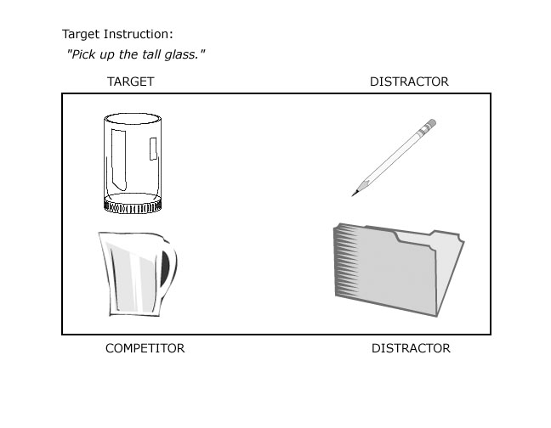

Slide 11
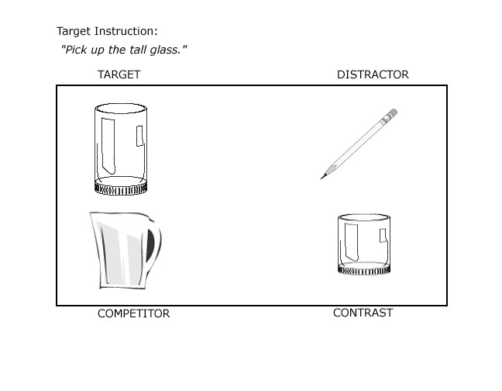

Slide 12
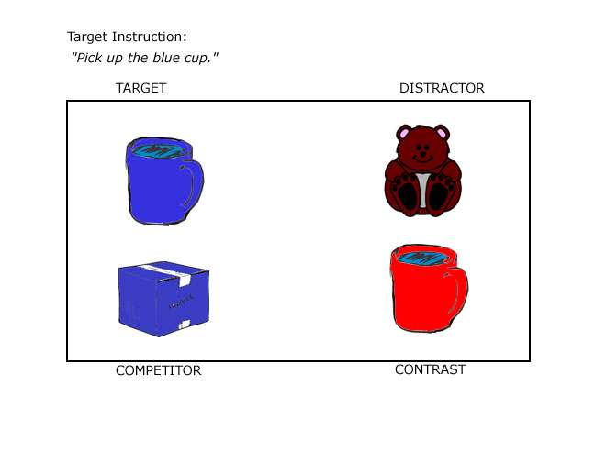

Slide 13
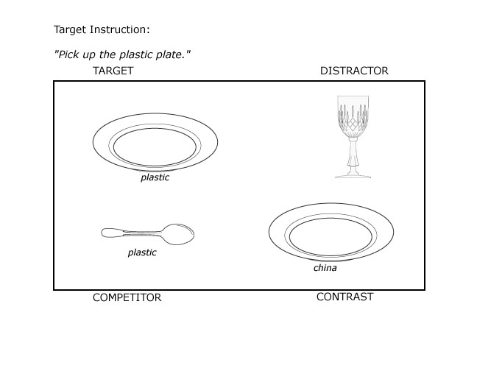

Slide 14
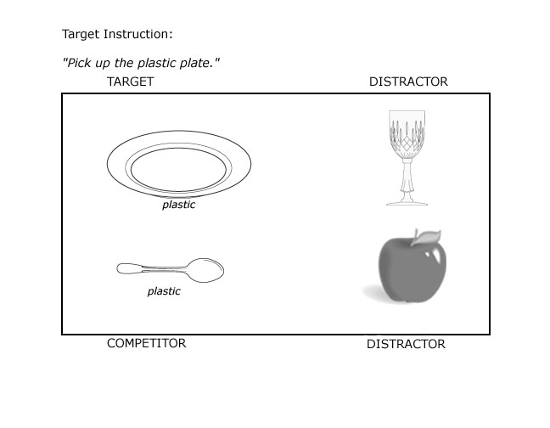

Slide 15
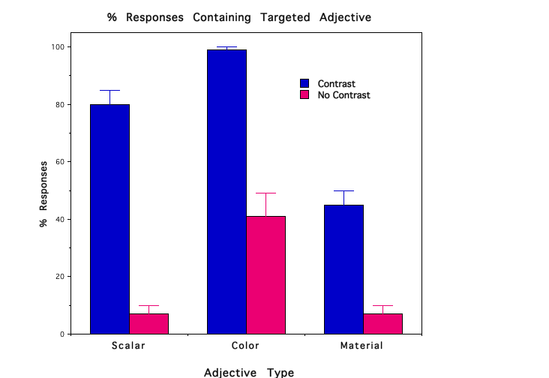

Slide 18
Hanna, Tanenhaus & Trueswell, 2003, JML
Late Match
Pick up the empty martini glass ...
1.00
0.80
Target
0.60
TargetO
Comp
0.40
CompO
0.20
Other
0.00
Time since onset of determiner (ms)
Early Match
Pick up the empty martini glass ...
1.00
0.80
Target
0.60
TargetO
0.40
Comp
CompO
0.20
Other
0.00
Time since onset of determiner (ms)

Slide 19
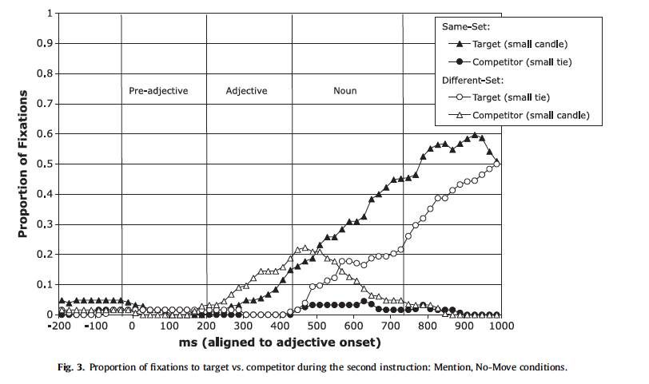
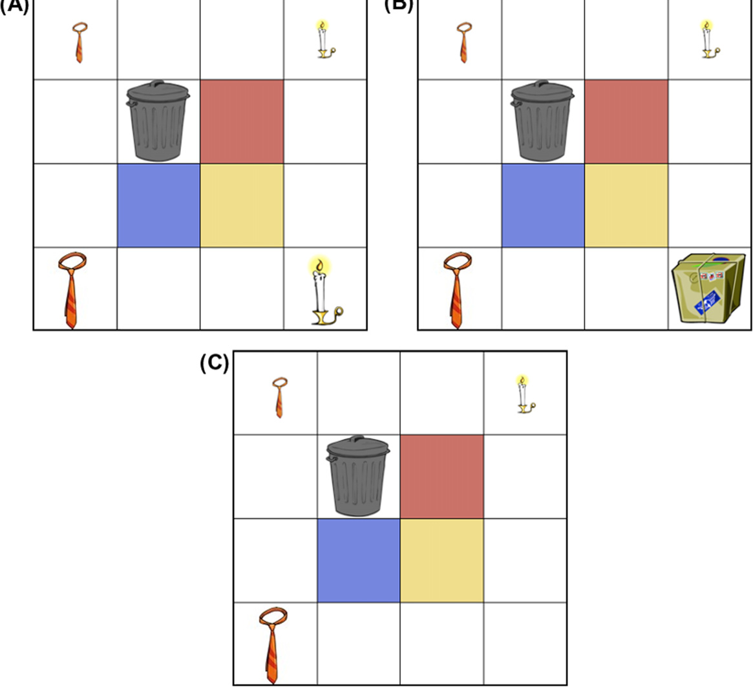
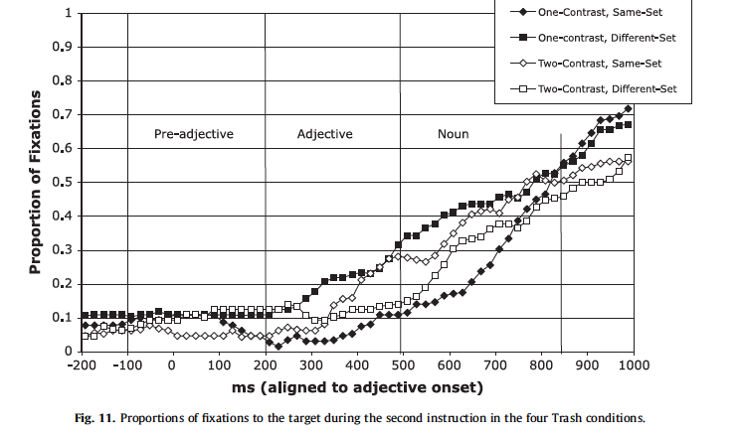
Wolter, Gorman & Tanenhaus, JML, 2011
Contrast, linguistic mention, and discourse

Slide 20
Implicature
Basic distinction:
Generalized implicature
Particularized Implicature

Slide 21
Time course of scalar implicature: subdomain in “experimental pragmatics”
Neo-Gricean account (Levinson):
some inferences automatized
*Relevance Theory account (Sperber):
all pragmatic inference is costly and follows
automatic literal interpretation
**Grammaticized account (Cherchia)

Slide 22
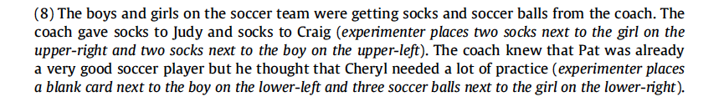
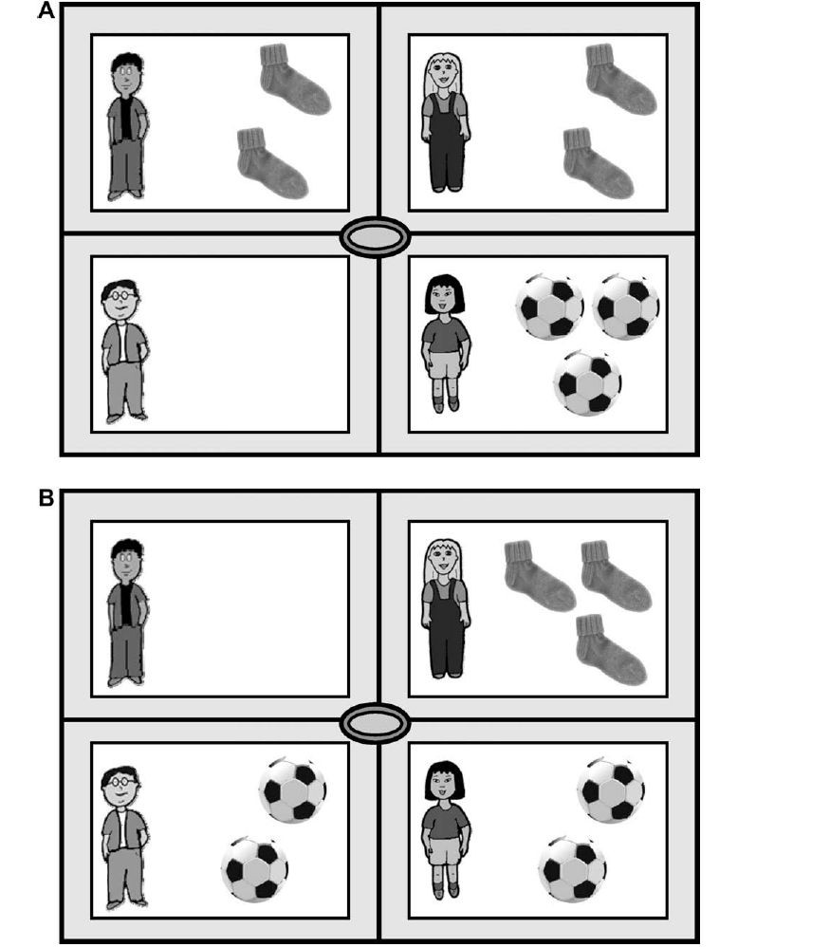
Huang & Snedeker, 2009, Cognitive Psychology

Slide 23
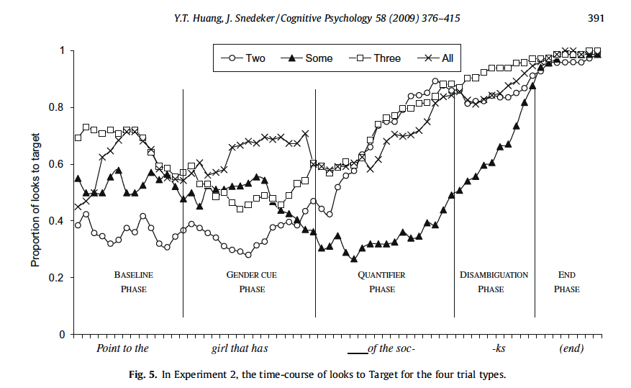

Slide 24
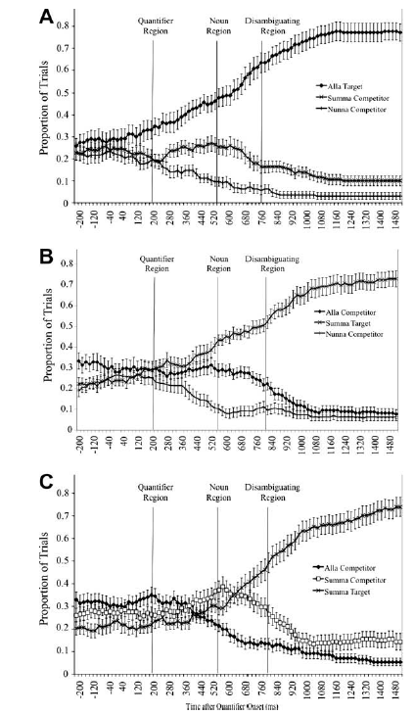
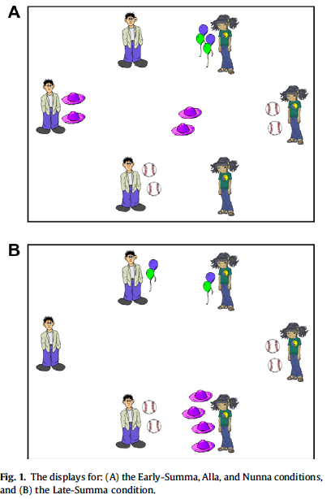
Grodner et al., 2010, Cognition

Slide 25
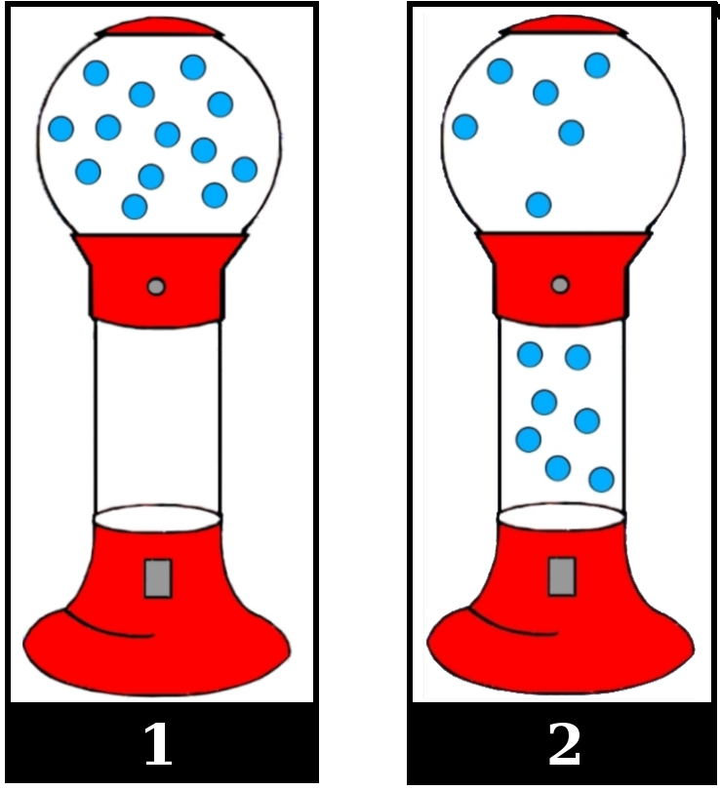
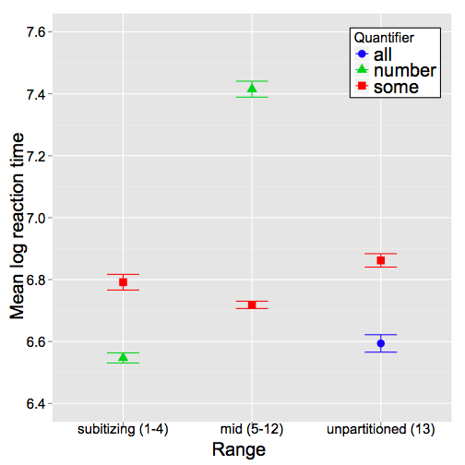
Degen & Tanenhaus (in prep)

Slide 27
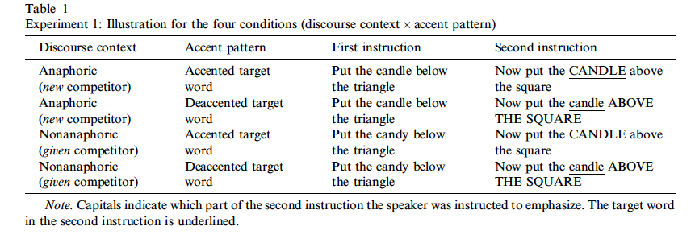
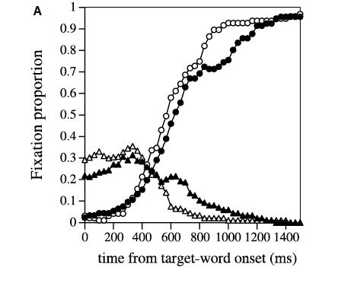

Slide 28
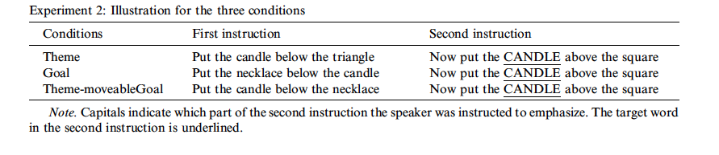
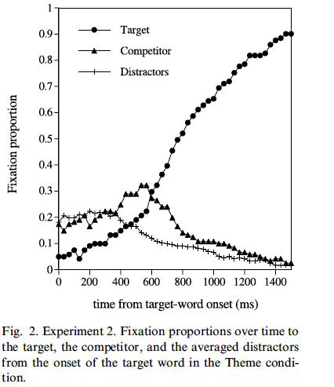
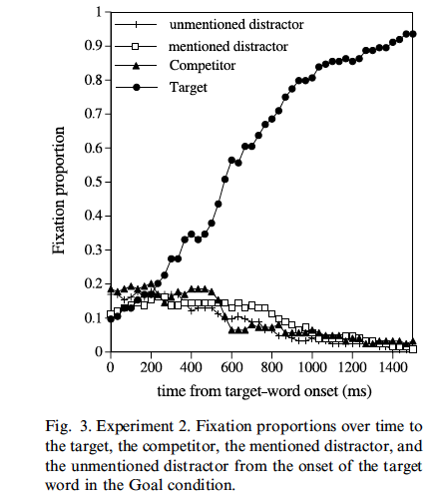

Slide 29
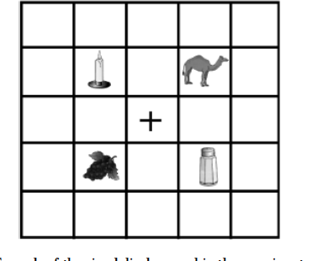
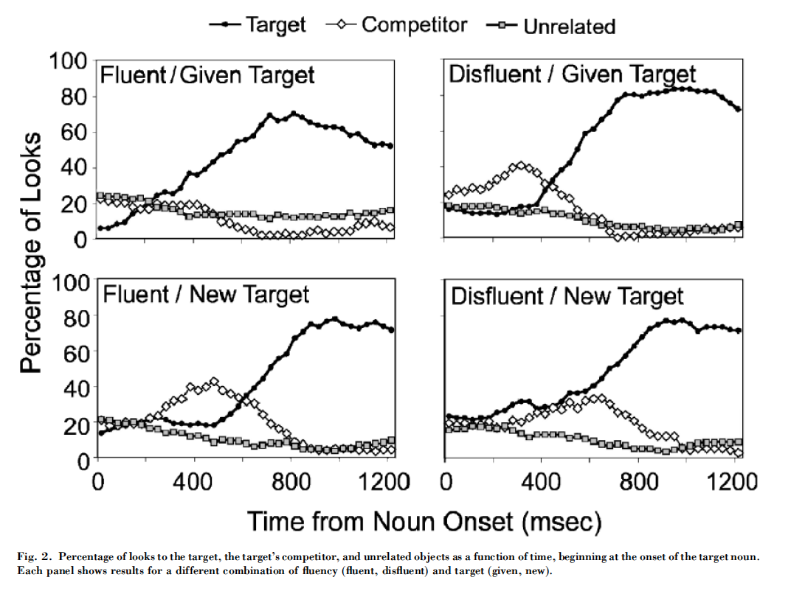
Arnold et al. (2004) Psychological Science
Put the grapes above the candle. Now put thiy uh/the candle/candy…

Slide 30
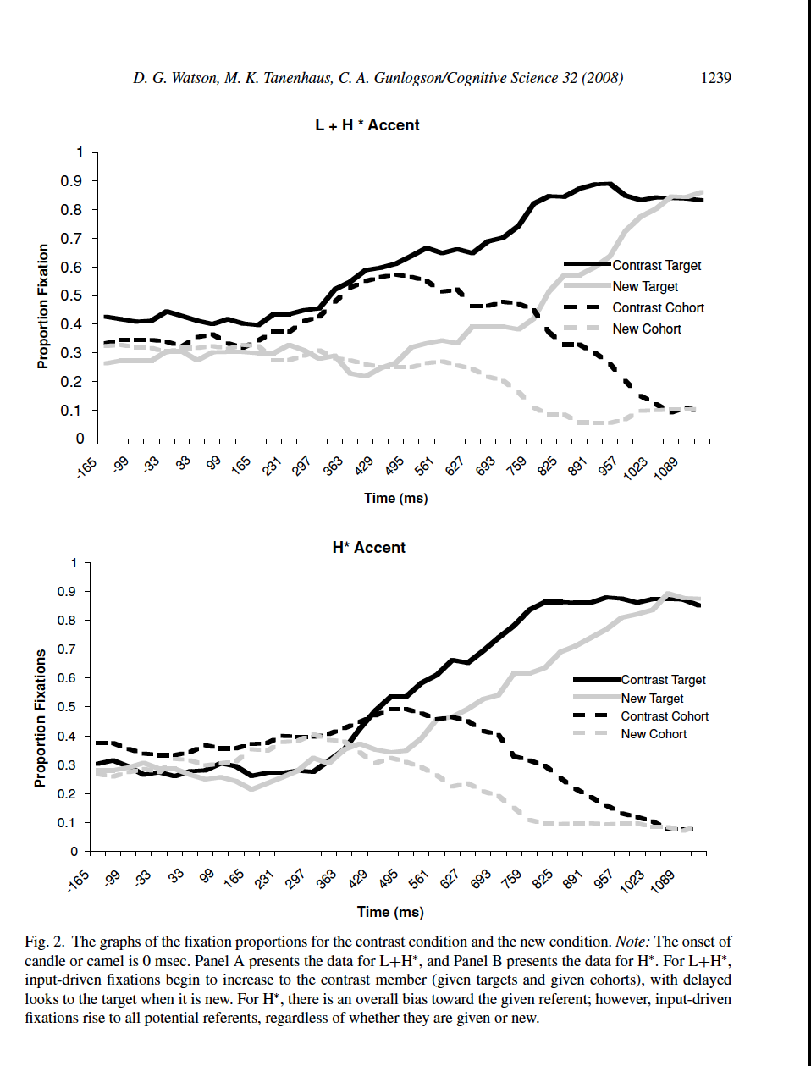
Watson, Tanenhaus & Gunlogson, 2008, Cognitive Science
6. a. Click on the camel and the dog.
b. Move the dog to the right of the square.
c. Now, move the camel/candle below the triangle.
H∗/L+H∗

Slide 31

Interactive conversation
Gibberish?
*ok, ok I got it* ele…ok
alright, *hold on*, I got another easy piece
*I got a* well wait I got a green piece RIGHT above that
above this piece?
well not exactly right above it
it can’t be above it
it’s to the…it’ doesn’t wanna fit in with the cardboard
it’s to the right, right?
yup
w- how? *where*
*it’s* kinda line up with the two holes
line ‘em right next to each other?
yeah, vertically
vertically, meaning?
up and down
up and down
Notes:
Interactive conversation (practical or task-oriented dialogue)

Slide 32
Approaches to Conversation/Dialogue
Collaborative Model (Clark, Brennan, Schober)
Speaker meaning is paramount
Interlocutors collaborate to create Common Ground
Grounding
Conceptual pacts
Basic principles of conversation fall out of understanding collaboration
Egocentrism
Speaker/listener
Interactive Alignment
Memory-based approaches

Slide 33
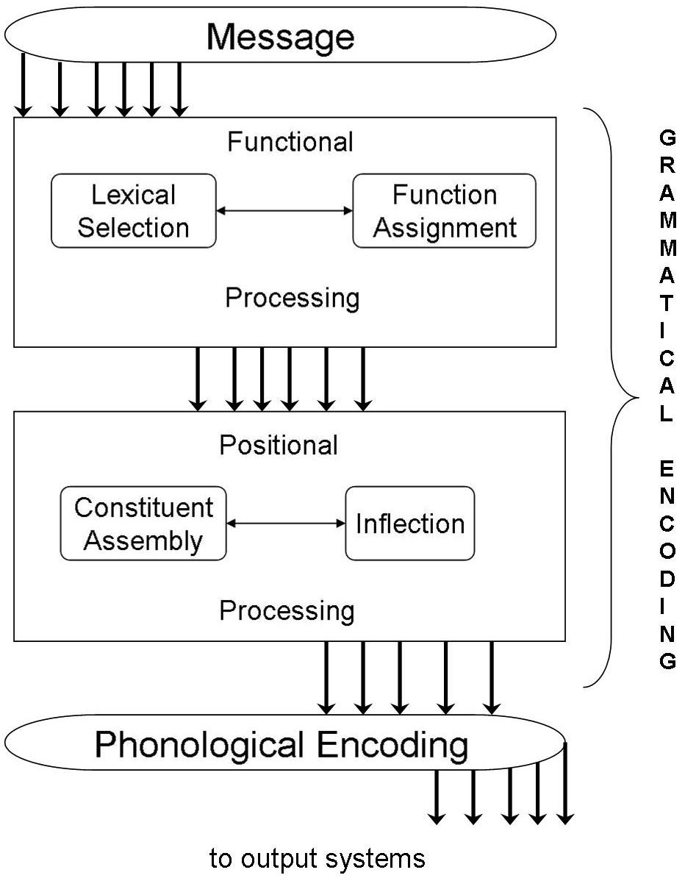
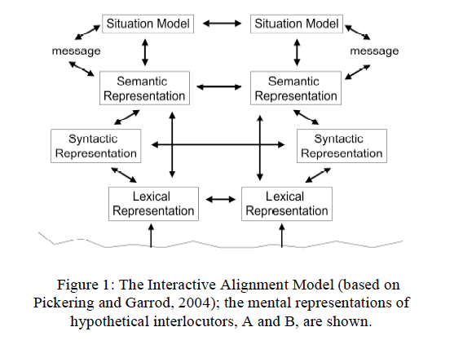
Interactive Alignment
Interactive Alignment
Pickering & Garrod
Basic observation/claim:
Monologue is hard, dialogue is easy
We align (converge on similar representations
Mechanism is “priming”
Gary Dell: “I hate it when people say couldn’t it just be priming, what’s priming? Priming is learning”

Slide 34
Outline: Perspective & Conversation
Two-stage models: (Egocentrism & Monitoring)
Perspective-taking (physical co-presence):
Partner-Specific Conceptual Pacts
Constraint-based approaches:
Perspective-taking (physical co-presence)
Partner-Specific Conceptual Pacts
Unscripted or mostly unscripted conversation
Art of Conversation (cross-recurrence)
Barnyard Oscars
Alignment of referential domains
Production in conversation

Slide 35
Conversation
Much of interactive conversation is usually viewed as a cooperative process*
Participants in a conversation work together to reach mutual understanding
* even competition involves cooperation

Slide 36
Common Ground
Philosophers, linguists and computational linguists usually assume a representation of mutual beliefs inferred using heuristics
Common ground can be inferred from multiple sources (Clark & Marshall):
Physical co-presence
Linguistic co-presence
Community membership

Slide 37
Processing questions
But do people actually track shared versus privileged information in real time comprehension and production?
Perhaps, it looks like people use this information, but really they aren’t:
Limited cognitive resources
Egocentric initial processing with second-stage consideration of errors if something goes wrong
Notes:
Like altruism

Slide 38
Shared vs. privileged information
Shared information (Common ground) Knowledge that is shared by both interlocutors (and is mutually accepted as such).
Privileged information (Privileged ground) Knowledge that is available to one interlocutor and not the other.

Slide 39
Common ground and perspective-taking
Analogy to issues in parsing wars of 90s
Two-stage versus constraint-based approaches
Two-stage
Simple heuristics, revision uses more information
Constraint-based
Use of probabilistic constraints, domain general mechanism
Are listeners egocentric?
Physical co-presence
Do speakers mark shared knowledge?
Names and descriptions

Slide 40
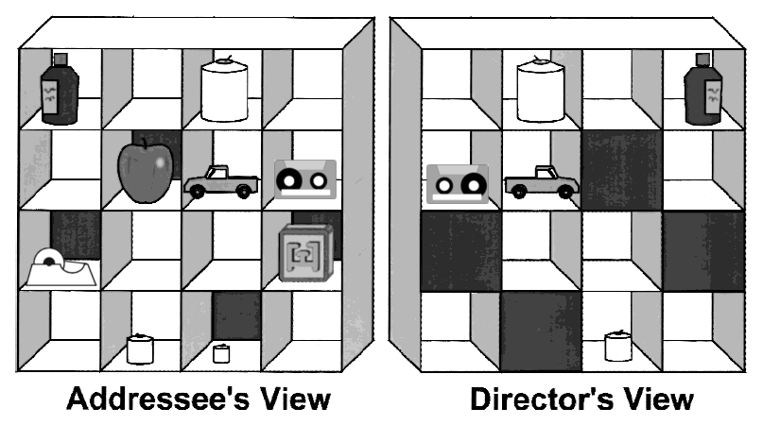
Evidence for Egocentrism
Keysar et al., 2000
Put the tape below the car
Notes:
Privileged vs common ground by virtue of physical co-presence
Listeners considered the privileged tape first.
→ The distinction between common and privileged ground is not integrated immediately.
Listeners considered the privileged small candle first
BUT the object in privileged ground is a better fit to the descriptive content of the referring expression than the intended referent in common ground.
Blue is poor referential fit/Red good. Color choice is impt. I’m a lifetime Yankee fan, but in deference to being in Boston, I’ve put the better referent in red
.

Slide 41
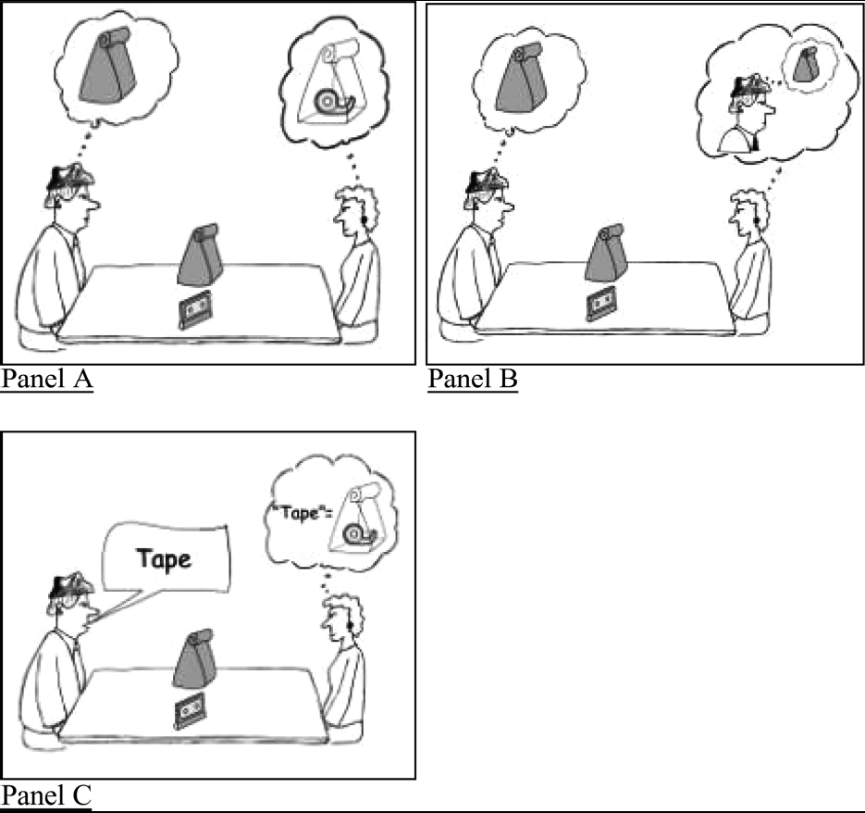
Evidence for egocentrism: holding the bag Keysar, Lin & Barr (Cognition, 2004)
pick up the tape
Participants considered the tape in the bag
Often picked up bag
The object in privileged ground is a better fit of the description than shared object.
Notes:
Result: ego first.
Disturbing result given linguistic research.

Slide 42
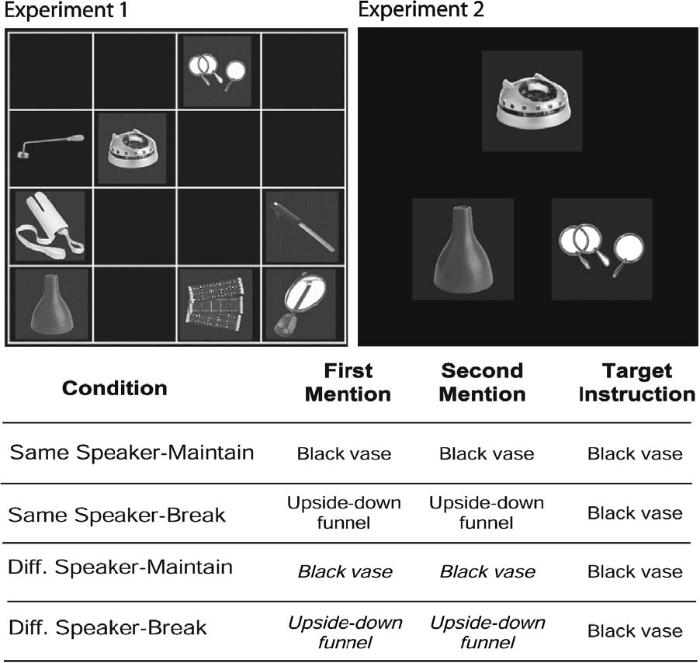
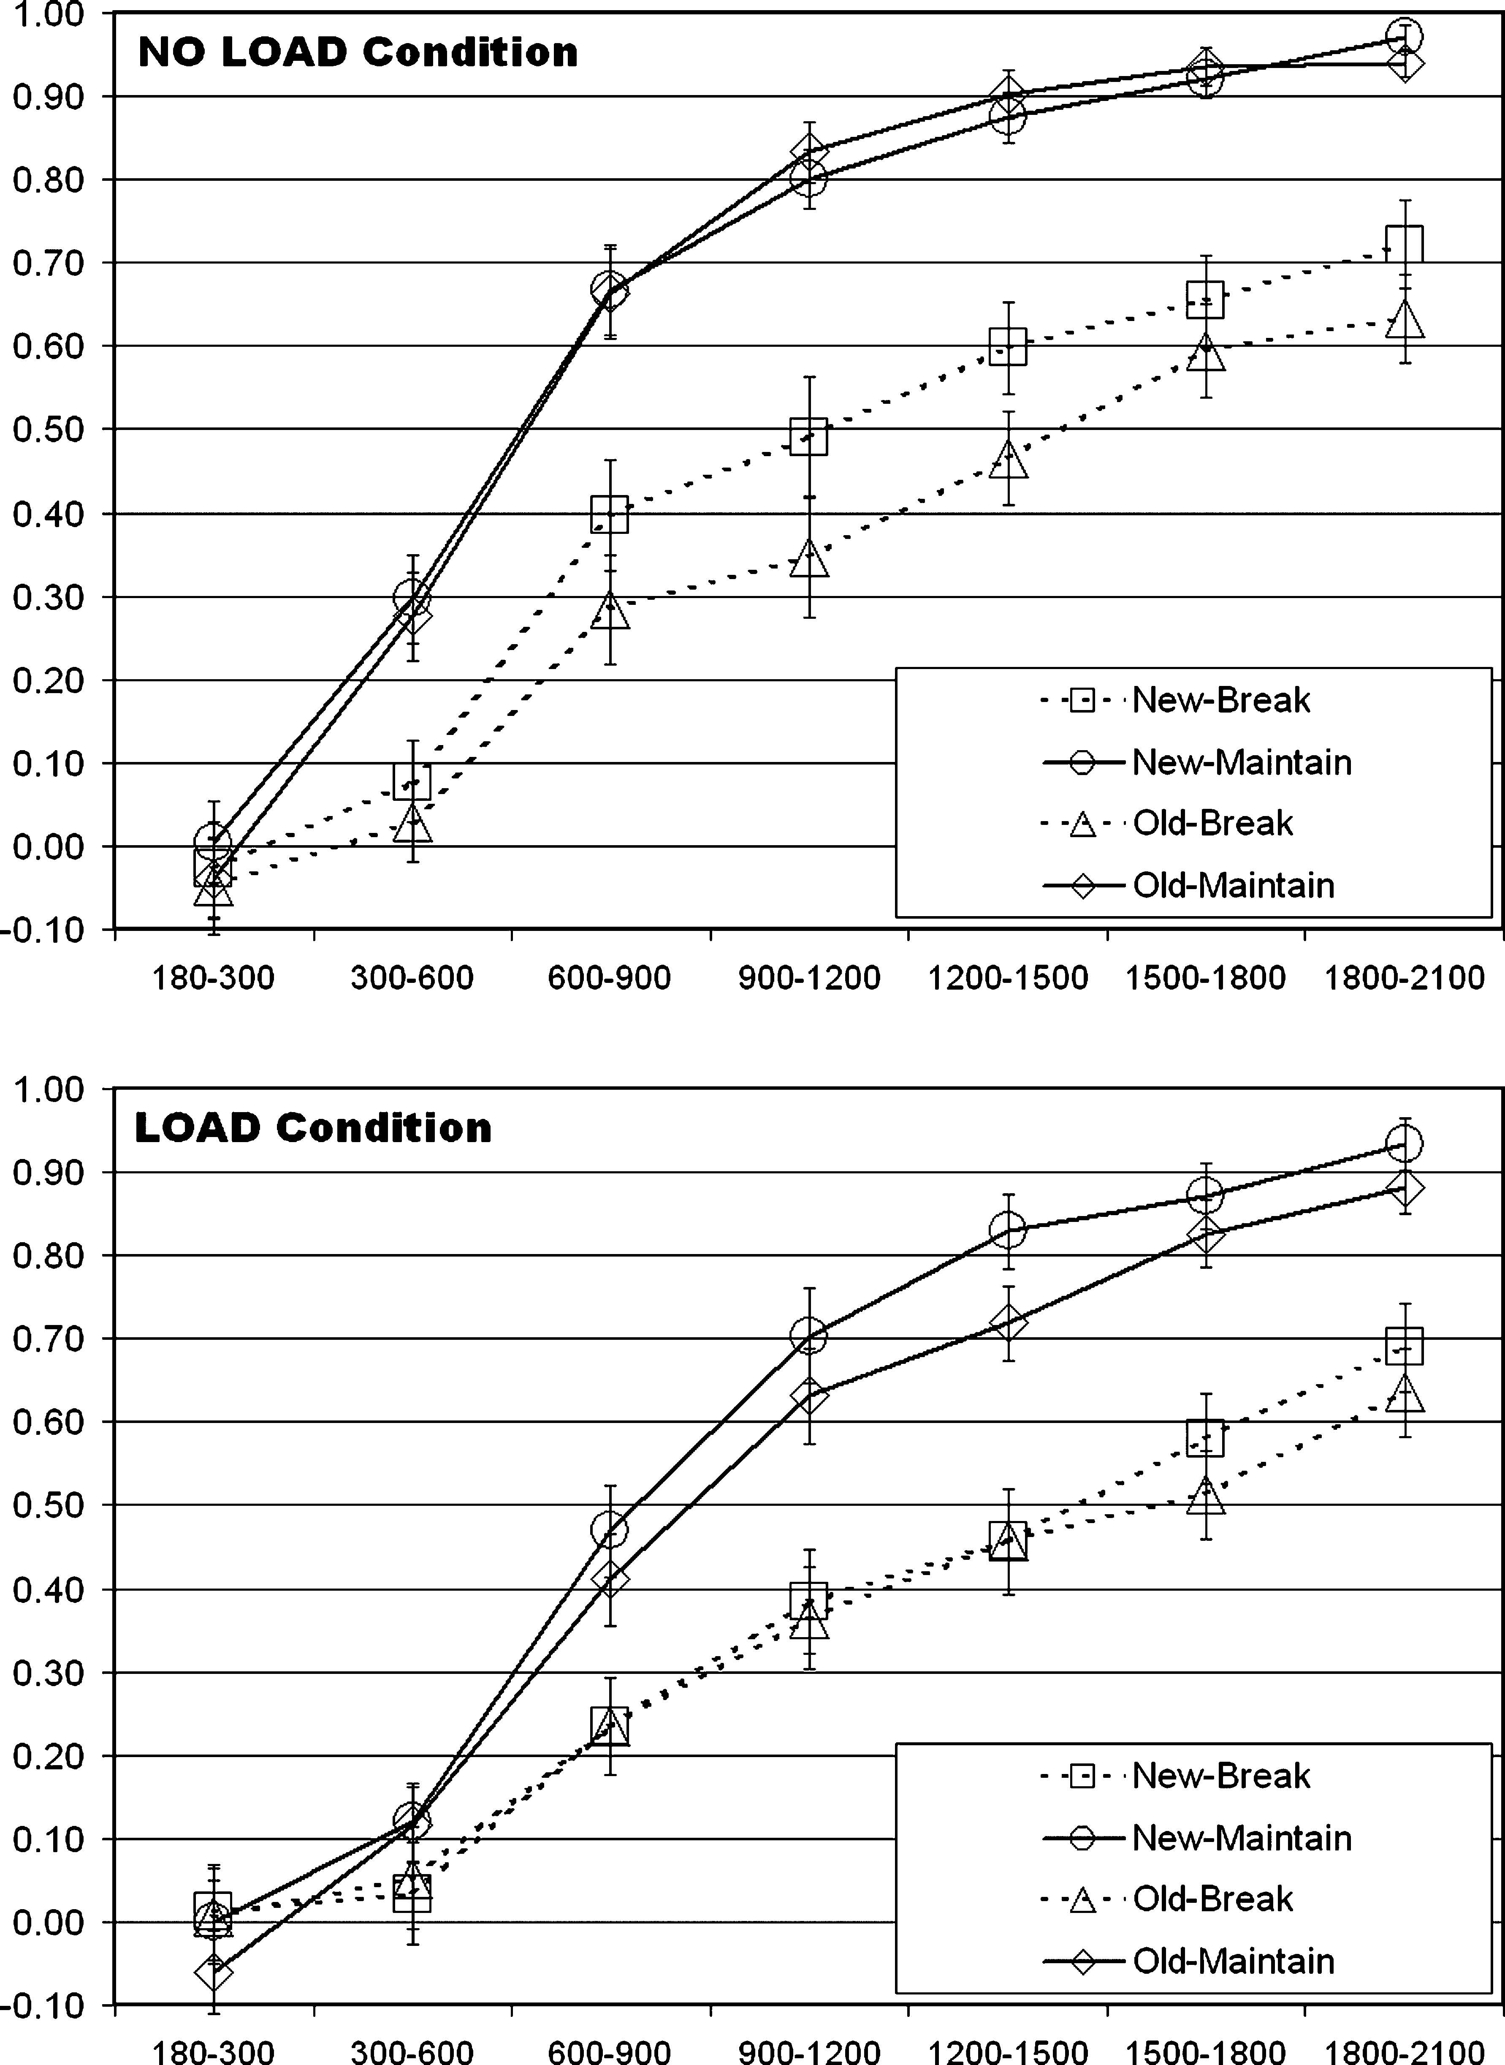
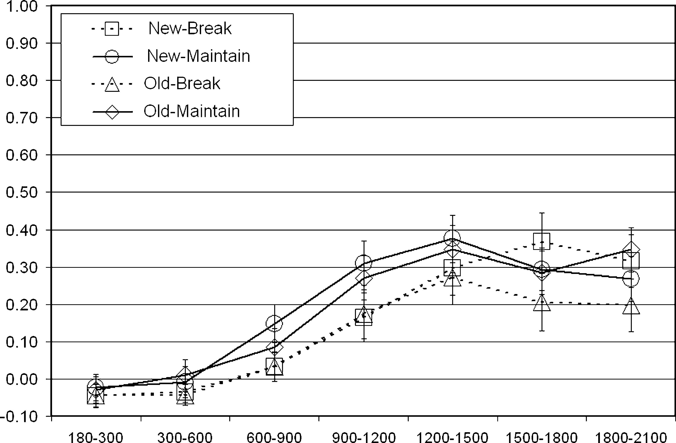
Kronmuller & Barr (JML, 2007)
Precedents/conceptual pacts: two stage model

Slide 43
The egocentric speaker (No Audience design)
Ambiguity avoidance
Limited use of prosody to disambiguate
Modification does not consider addressee perspective

Slide 44
Context-independent initial processing
Egocentric initial processing with second-stage consideration of errors if something goes wrong
Been there, seen that:
Two-stage models of ambiguity resolution
The horse raced past the barn fell.
The raft floated down the river sank
Constraint-based reanalysis of problem/data*
The landmine buried in the sand exploded
The salmon released in the stream spawned
* As(n)ide about teaching and confusion

Slide 45
Evidence for Egocentrism
Keysar et al., 2000
Put the tape below the car
Notes:
Privileged vs common ground by virtue of physical co-presence
Listeners considered the privileged tape first.
→ The distinction between common and privileged ground is not integrated immediately.
Listeners considered the privileged small candle first
BUT the object in privileged ground is a better fit to the descriptive content of the referring expression than the intended referent in common ground.
Blue is poor referential fit/Red good. Color choice is impt. I’m a lifetime Yankee fan, but in deference to being in Boston, I’ve put the better referent in red
.

Slide 46
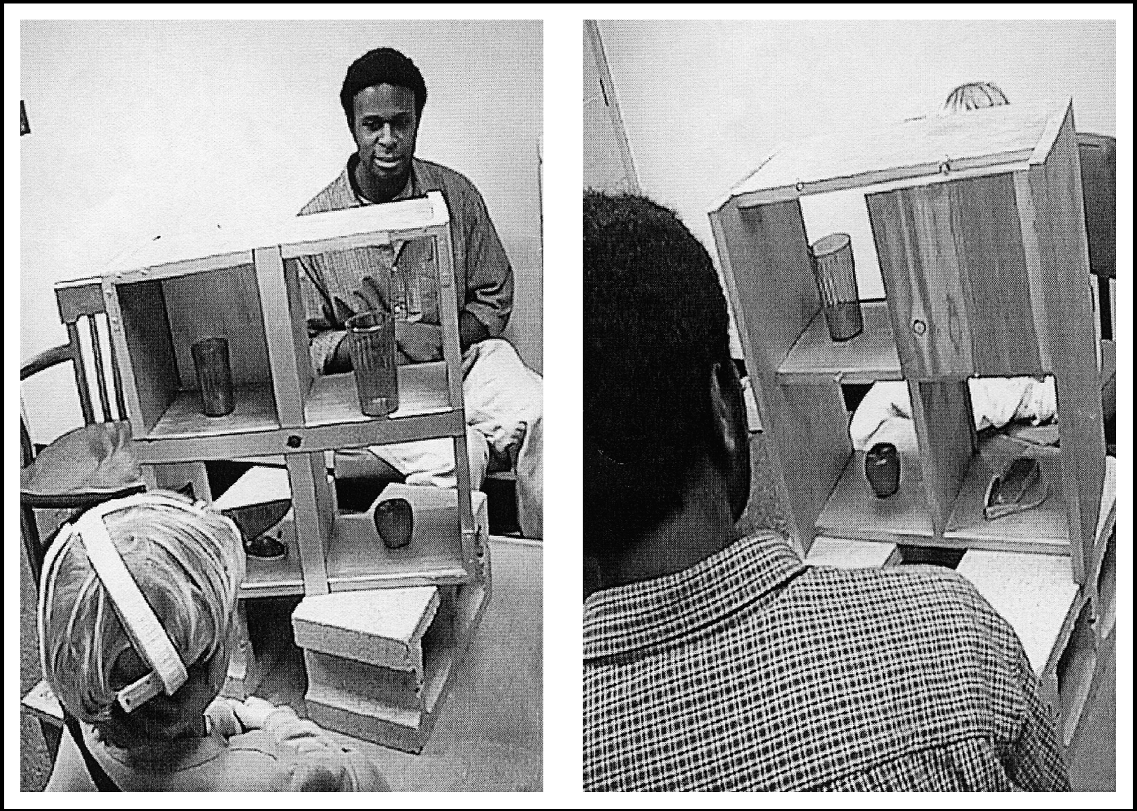
Nadig & Sedivy (Psych Science, 2002)
Children used scalars most often when contrast objects in common ground, least often when no contrast and intermediate when contrast is in privileged ground.

Slide 47
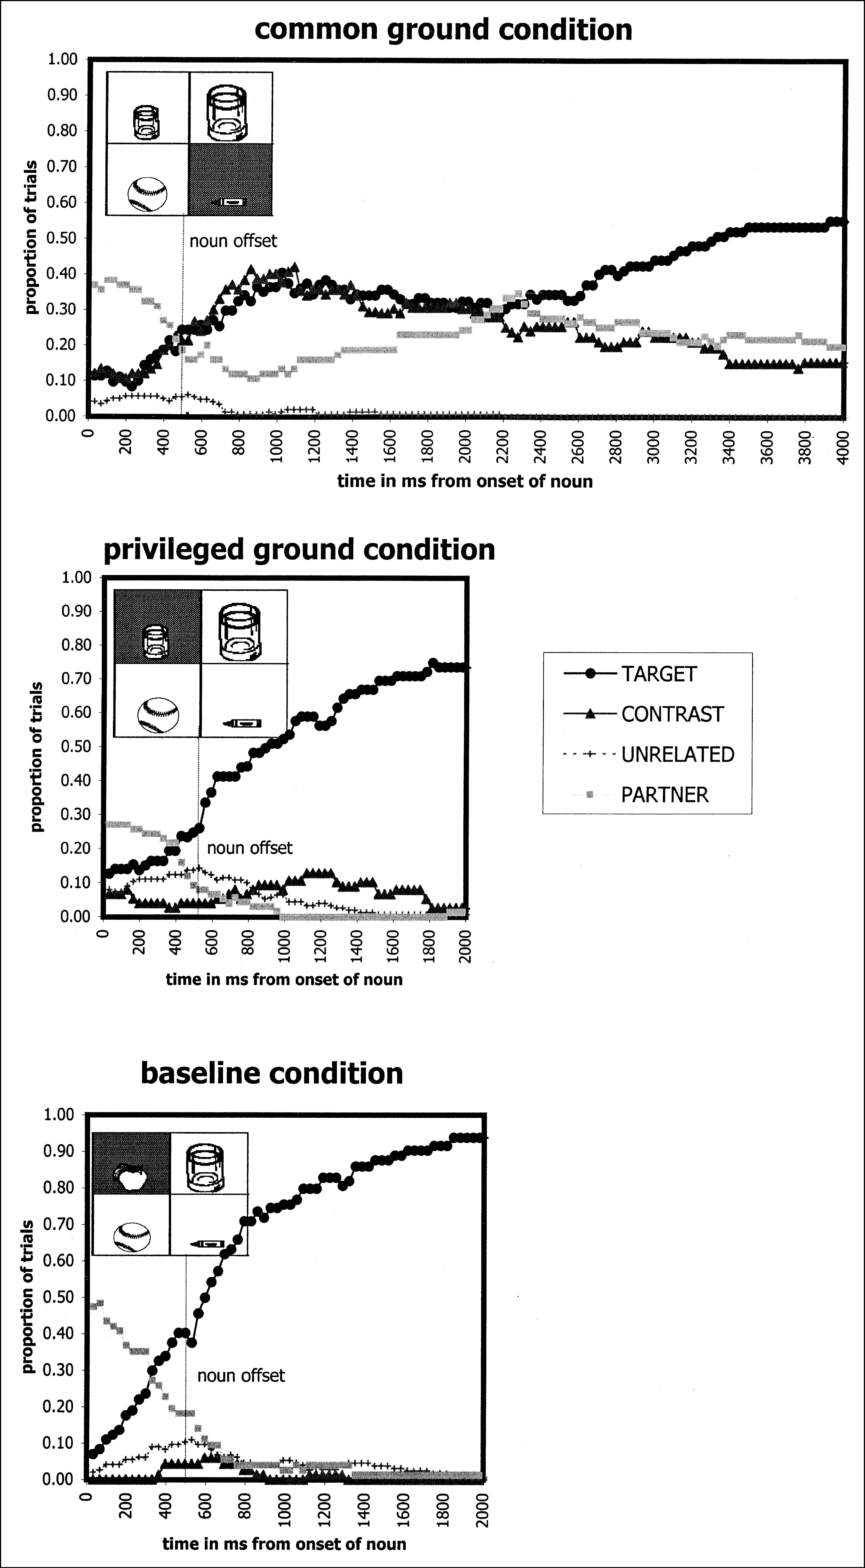
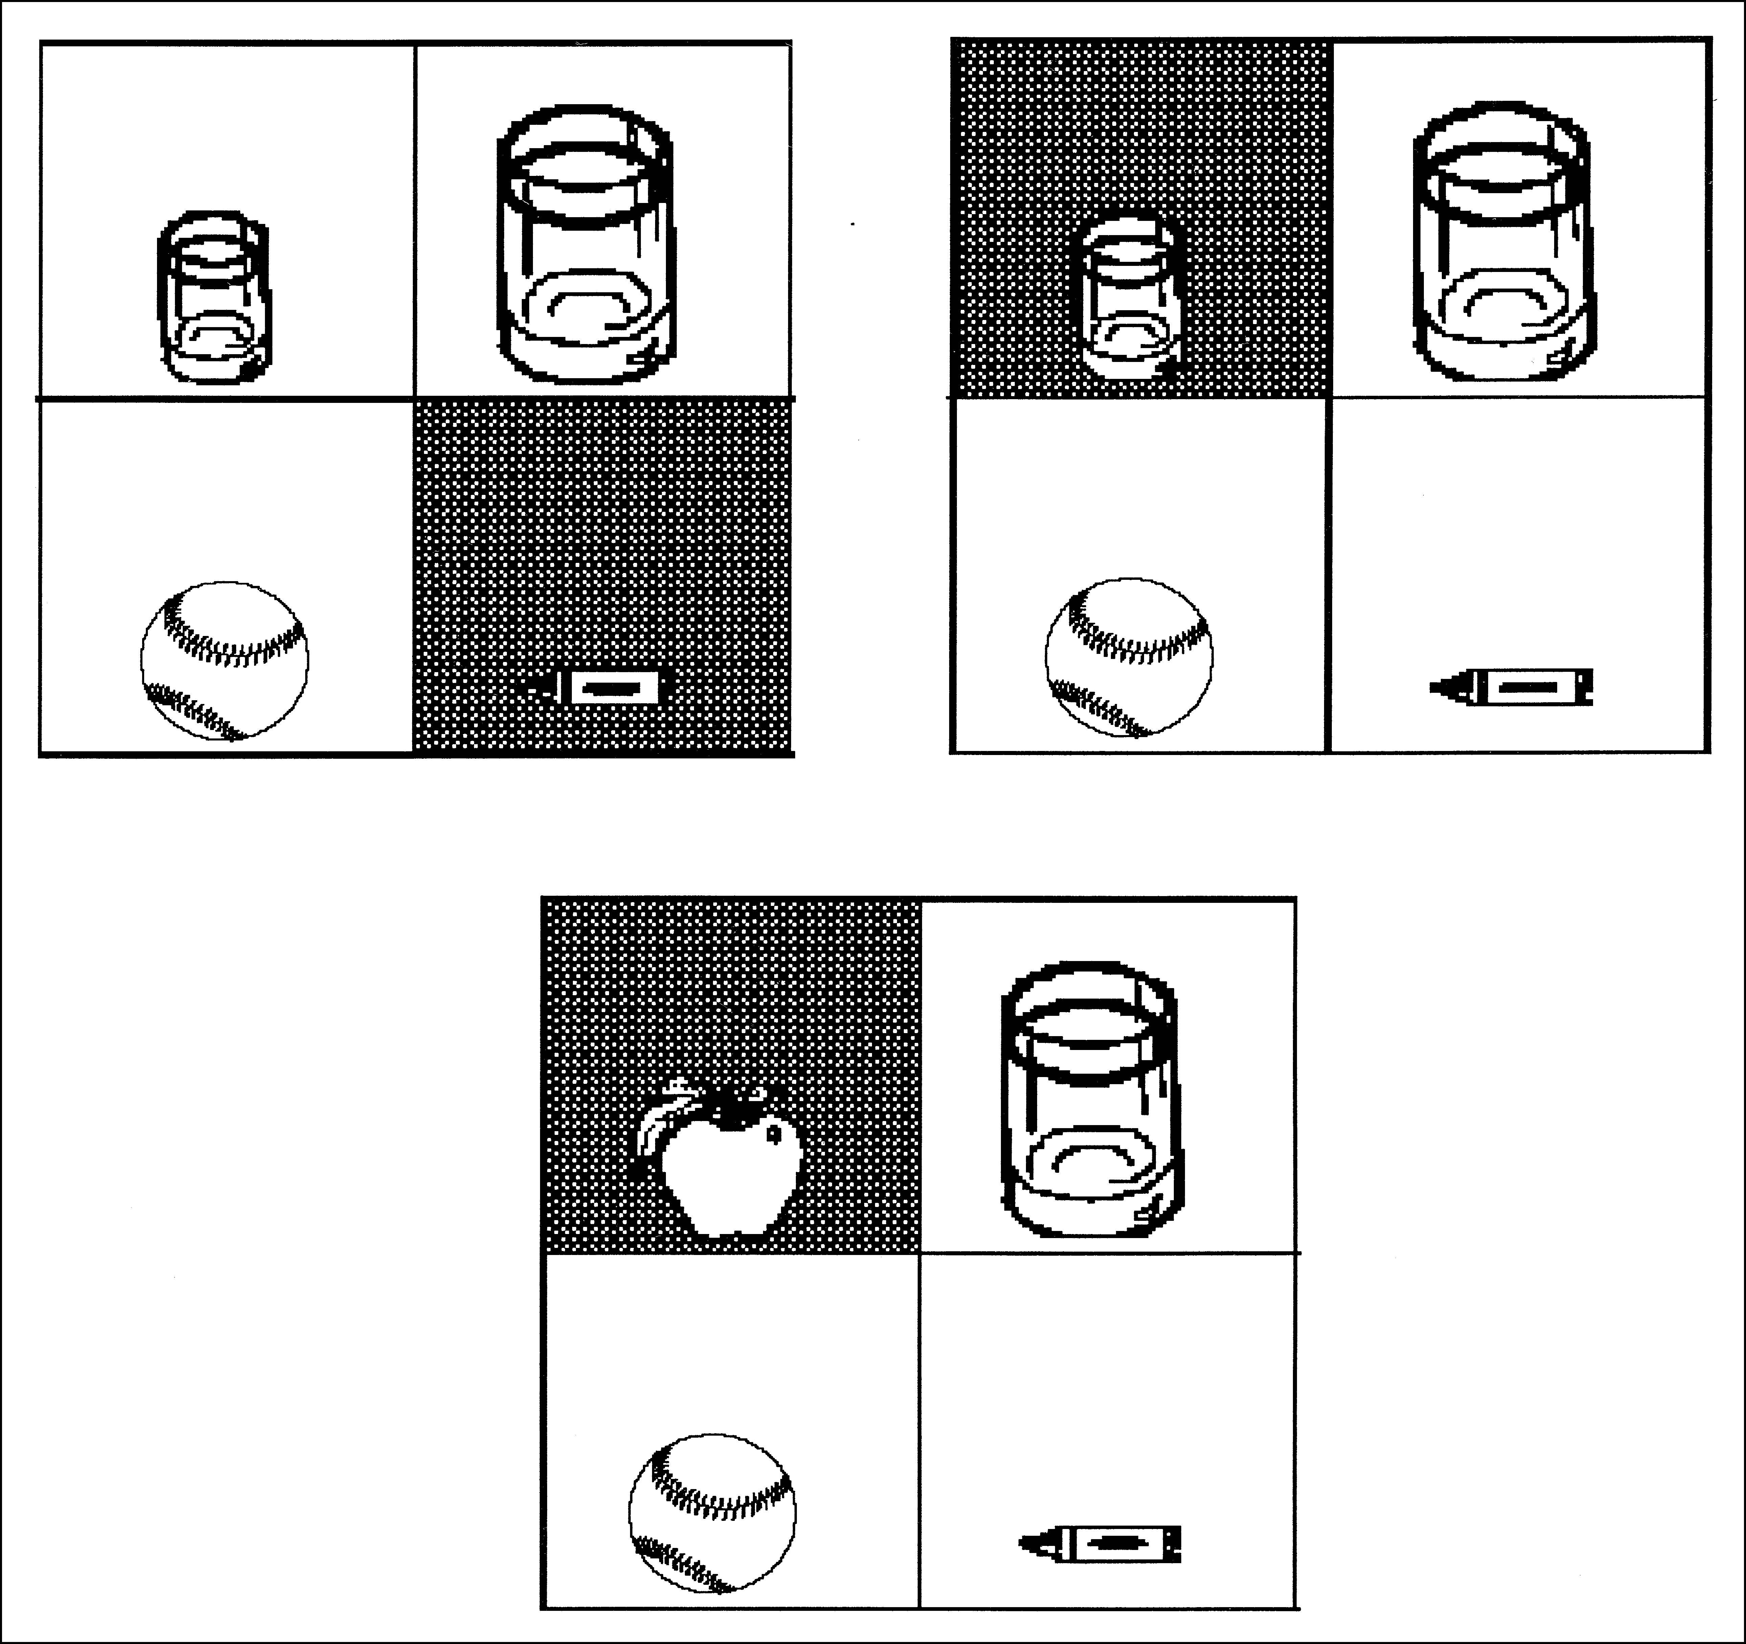
Problem 1: infelicitous instruction.
Problem 2: global ambiguity. Perhaps integrate this information as last resort?

Slide 48
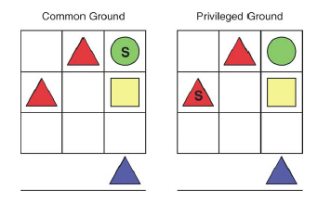
Hanna, Tanenhaus & Trueswell (2003)
“Now put the blue triangle on the red one”
Notes:
Same result, same problem:

Slide 50
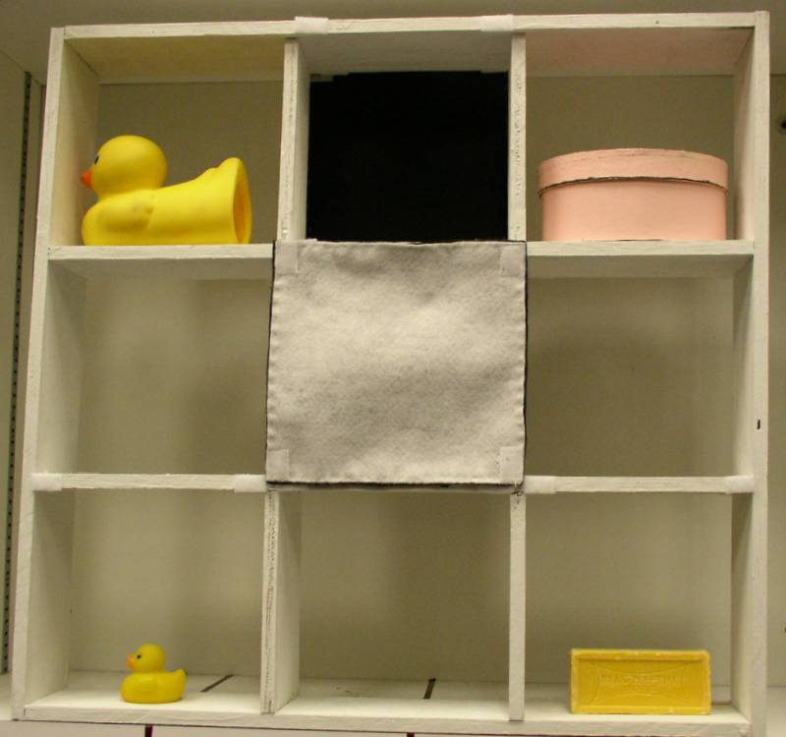
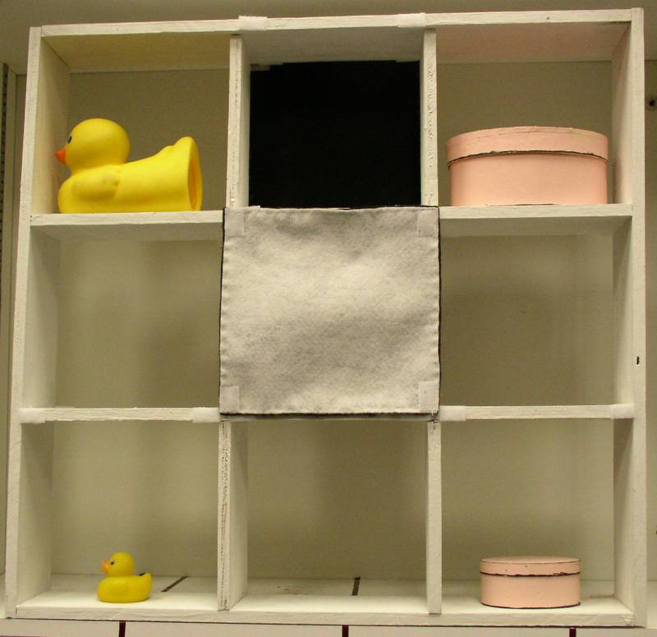
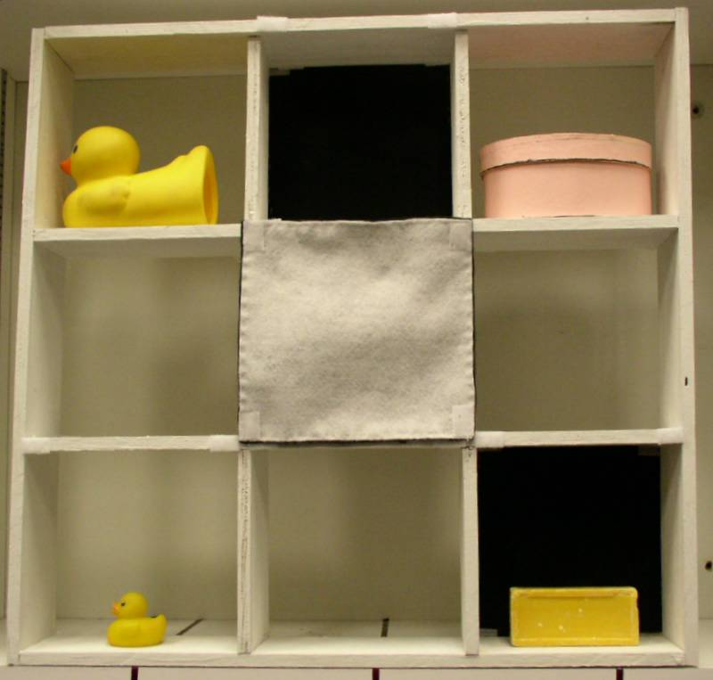
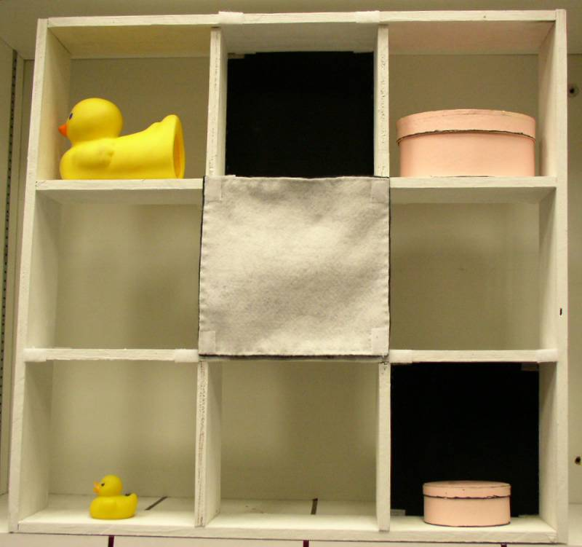
2 (one contrast vs. two contrasts) X 2 (shared vs. privileged ground).
pick up the big ...
two shared
one shared
early
late
one privileged
two privileged
early
Early or late?
Notes:
The critical condition is …
If listeners process from their egocentric perspective, we should see late disambiguation like the 2-contrast condition.
If listeners integrate perspective information in real time, we should see early disambig. Because from the perspective of the speaker there is only one contrast.

Slide 51
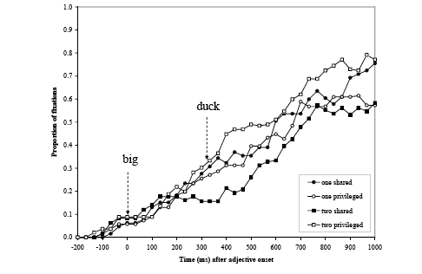
Two privileged is EARLY
Notes:
When only one of the contrasts is shared, early disambiguation

Slide 52
On the Horizon
TOWARDS INTEGRATING THE LITERATURE
The time course of time-course questions:
Stage 1. Clairol stage: does it or doesn’t it
(it doesn’t!): That’s really deep/interesting
stage models (memory/processing limits)
(yes, it does!)….when strong enough manipulation
constraint-based models
Stage 2. Recursive stage:
Different results/conclusions associated with different lineage/different geographic locations
(you didn’t look early enough/ carefully enough; can’t conclude anything from negative evidence; too unconstrained--can explain anything, can’t falsify; yes it does too doesn’t/does; literature equivocal need more research; Occam’s Razor; would Grandma be surprised; etc.)
Stage 3. Attempt to integrate stage: (Bayesian cue integration)

Slide 53

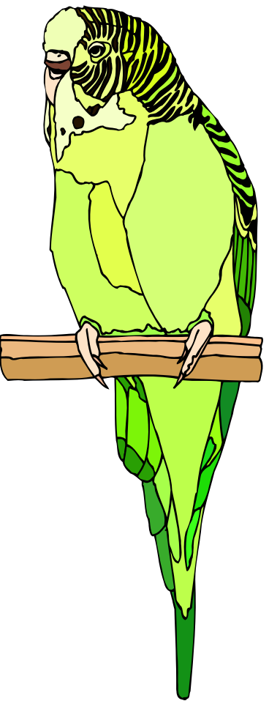
Cue integration
State

Slide 54
Kronmuller & Barr (JML, 2007)
Precedents/conceptual pacts: two stage model

Slide 55
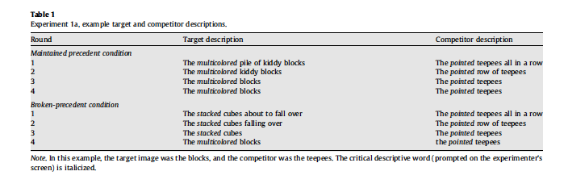
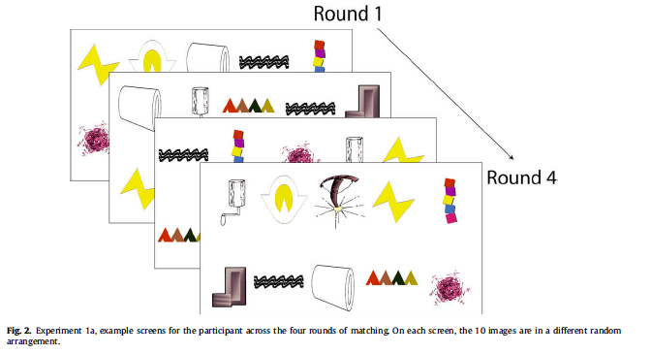
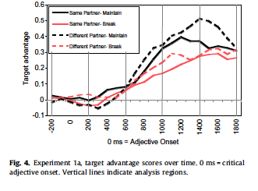
Brown-Schmidt (2009, JML)

Slide 56
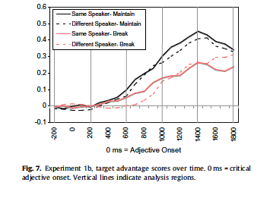
Brown-Schmidt (2009, JML)

Slide 57
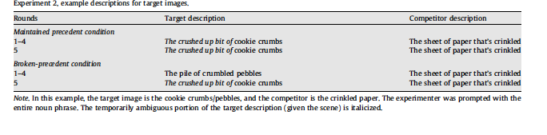
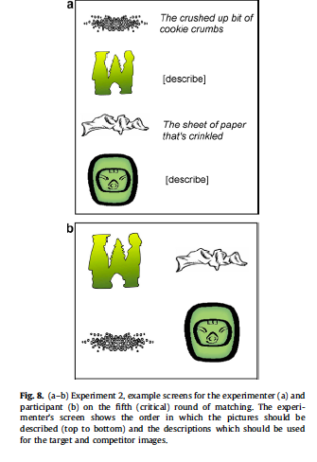
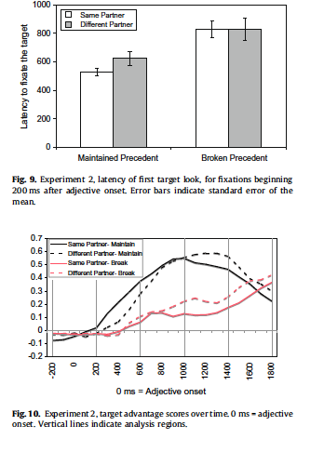
Broken precedent same speaker penalty shows up only in first-half of experiment

Slide 58
Problems with confederates and scripted instructions
No joint goals.
People behave differently with confederates.
Declarative request assumes addressee can perform an action to satisfy request.
Matcher role in combination with Director who instructs creates assumption of omniscience.
Subject relinquishes control, tries not to act dumb, assuming evaluation.
Consequence: might encourage egocentrism*
*mirror effects in social facilitation

Slide 59
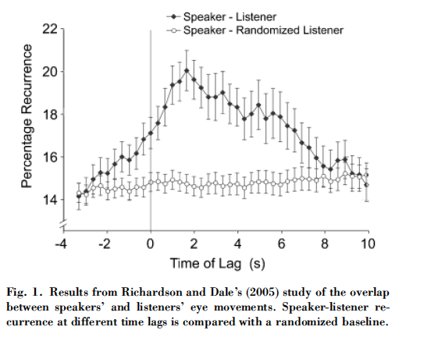
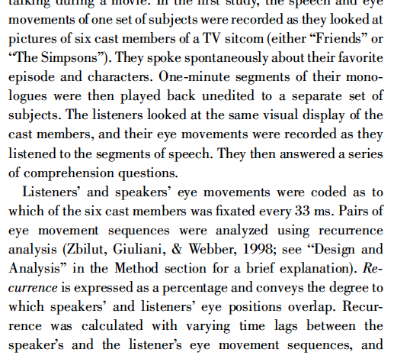


Different preceding contexts for participants (e.g., ‘‘The still life objects in the original canvas have separated from the table and float in the air, and even the particles of paint have broken loose from the canvas.’’) or Dali’s personality and theory (e.g., ‘‘The paranoiac critical method entailed the creation of a visionary reality from elements of dreams, memories, and psychological or pathological distor- tions. At times, Dali would stand on his head to induce hallucinations.’’).
Notes:
Different preceding contexts for participants (e.g., ‘‘The still life objects in the original canvas have separated from the table and float in the air, and even the particles of paint have broken loose from the canvas.’’) or Dali’s personality and theory (e.g., ‘‘The paranoiac critical method entailed the creation of a visionary reality from elements of dreams, memories, and psychological or pathological distor- tions. At times, Dali would stand on his head to induce hallu- cinations.’’).

Slide 60
Referential domains in interactive conversation
Targeted language games approach:
task-oriented conversation
“game-board” and “pieces” increase likelihood of “trials
can be combined with some scripted trials or more targeted confederate follow-ups.
Strengths:
naturalness
strategies reflect joint goals
Weaknesses:
noisy data
analysis is very time-consuming
absence of control

Slide 61
Referential domains in interactive conversation
Tasks need to be truly collaborative.
Language must be created by the interlocutors (non-scripted).
Need real-time measure.
This is a methodological nightmare

Slide 62
Heuristics reconsidered
Two-stage parsing models failed because the initial stage was NOT a heuristic
Constraint-based approaches worked because:
The information was in the input
Domain-general mechanisms sufficient
But egocentric processing might be a heuristic in conversation
Is there information in the input?
Are there supporting domain-general mechanisms?

Slide 63
Connecting knowledge state to the input/output
Does information in an utterance provides probabilistic information about (assumed) knowledge state?
Aside about audience design and ambiguity avoidance
The landmine buried in the sand exploded
Case 1: Information questions vs assertions:
Assertions can be about both information in speaker privileged and common ground.
The coffee is ready.
Information questions are about information the speaker assumes the addressee might know.
Is the coffee ready?
Case 2: Forms of referring expressions
Names versus descriptions

Slide 64



Processing Questions: The Barnyard Oscars
Sarah Brown-Schmidt
Christine Gunlogson

Slide 65
Referential domains in interactive conversation
Proportion of questions referring to:
Common Ground | Speaker’s Privileged Ground | Addressee’s Privileged Ground
.00 (.01) | .06 (.11) | .94 (.11)
What’s below the cow with the hat?

Slide 66

Referential domains in interactive conversation
What’s below the cow with the hat?

Slide 67

Perspective with questions
Late point-of-disambiguation trials
(E) What’s in the bottom middle?
(Participant: A horse with glasses)
(E) What’s above the cow with the hat?
Early point-of-disambiguation trials
(E) What’s in the bottom middle? (Participant: A pig with shoes)
(E)What’s above the cow with the hat

Slide 68
Tentative Conclusion
Interlocutors access information about common and privileged ground on an “as needed basis”. This emerges when we can observe real-time interactive conversation where participants have joint goals.

Slide 69
Brown-Schmidt & Tanenhaus, (Cognitive Science, in press)

Slide 72
Cohorts
Cohort trials from “calibration checks” Experimenter asks the participant wearing the tracker to look at some of the blocks, e.g., now, look at the cloud, ok, now look at the pencil. A clown or penguin is in the same area
Cohort trials from conversation:
One participant mentions a picture block when its cohort is in the same area on the board (cloud when clown is in the same area).

Slide 73



Slide 74
Participants replace stickers / with blocks This is mid-way through the task:
Subject 1’s Board
Subject 2’s Board

Slide 75
Point of Disambiguation
Definite referring expressions assume a uniquely identifiable referent with respect to a circumscribed referential domain.
Put it above the red block.
Put it above the red vertical block.

Slide 76



Slide 77
Why are there so many linguistically ambiguous referential expressions ?
Speakers linguistically disambiguate only when there is a salient (proximal and task-relevant) competitor in their referential domain (Beun & Cremer, 2003)

Slide 78
Are addressees confused?

Slide 80
Summary
Speakers are frequently “underspecifying”
Listeners are not confused
Speakers disambiguate only when there is a salient (proximal and task-relevant) competitor in their referential domain.
Speakers and addressees have similar, task-relevant, referential domains

Slide 81
Heuristics reconsidered
Two-stage parsing models failed because the initial stage was NOT a heuristic
The information was in the input
Domain-general mechanisms sufficient
But egocentric processing might be a heuristic in conversation
Is there information in the input?
Are there supporting domain-general mechanisms?

Slide 82
Connecting knowledge state to the input/output
Does information in an utterance provides probabilistic information about (assumed) knowledge state?
Aside about audience design and ambiguity avoidance
The landmine buried in the sand exploded
Case 1: Information questions vs assertions:
Assertions can be about both information in speaker privileged and common ground.
The coffee is ready.
Information questions are about information the speaker assumes the addressee might know.
Is the coffee ready?
Case 2: Forms of referring expressions
Names versus descriptions

Slide 83
Processing Questions: The Barnyard Oscars
Sarah Brown-Schmidt
Christine Gunlogson

Slide 84
Proportion of questions
What’s above the cow with the hat?
Common Ground | Speaker’s Privileged Ground | Addressee’s Privileged Ground
.00 (.01) | .06 (.11) | .94 (.11)

Slide 85
Targeted language game with confederate trials
Late point-of-disambiguation trials
(E) What’s in the bottom middle?
(Participant: A horse with glasses)
(E) What’s above the cow with the hat?
Early point-of-disambiguation trials
(E) What’s in the bottom middle? (Participant: A pig with shoes)
(E)What’s above the cow with the hat
cow
hat

Slide 86
Wu & Keysar
Wu & Keysar propose that speakers use a global strategy to assess shared vs. privileged status.
They assume:
Interlocutors cannot effectively keep track of the shared vs. privileged status of individual names
They propose:
When overlap in information between two people is extensive, using one’s own information should work just fine because it is most likely to be shared.
Notes:
Speakers determine how much they can rely on their own knowledge depending on an estimate of how much information is shared.
“High overlap directors also used more names with objects whose names only they knew, thereby confusing their addressees
more often than low-overlap directors.”
“The less confusion, the more effective the communication is considered to be” p.2
“People may avoid altogether considering whether information is shared when they share a lot of information with the
other. They may simply use their own information, behaving as if it is shared” p.3
“when overlap in information between two people is extensive, using one’s own information should work just fine because it is most likely to be shared.” p.4
“.” p.4

Slide 87
























Wu & Keysar 2007, Cognitive Science
danzo | nelke | floogle | banpar | abypit | flukium
rovzer | etrett | pright | grampent | buttly | jovethun
stoggy | inclyder | chitney | archow | bolgan | hydron
fluliket | cortlog | inta | bluchek | molget | flazap

Slide 88
Wu & Keysar: Training-High Overlap
learned together: shared
danzo | nelke | floogle | banpar | abypit | flukium
rovzer | etrett | pright | grampent | buttly | jovethun
stoggy | inclyder | chitney | archow | bolgan | hydron
fluliket | cortlog | inta | bluchek | molget | flazap
speaker only: privileged

Slide 89
Wu & Keysar: Training-Low Overlap
danzo | nelke | floogle | banpar | abypit | flukium
rovzer | etrett | pright | grampent | buttly | jovethun
stoggy | inclyder | chitney | archow | bolgan | hydron
fluliket | cortlog | inta | bluchek | molget | flazap
learned together: shared
speaker only: privileged

Slide 90

Testing
It’s like a rectangle and a triangle.
The speaker was instructed to get the addressee to click on the correct shape “as quickly and accurately as possible”
18 trials:
6: shared shapes
6: privileged shapes
6: new shapes
molget.
speaker
addressee

Slide 91
Linking Hypothesis
privileged
It’s like a rectangle and a triangle.
shared
molget.
Speakers will only use a name when it is shared.
speaker

Slide 92


All names
Names first

Slide 94
Summary of names and future directions
Forms of utterances mark speaker assumptions
Speakers care, addressees have input cues
Shared experience important
Learn together--memory trace
Learn separately--knowledge there, not accessible
Some generalization from third-party
What happens in more natural situations?
Bayesian perspective might be useful here
Do speakers use priors about others’ knowledge*
Tree expert example
Maple, Oak, Dogwood, Stewartia
Do speakers update priors in a reasonable way
Do interlocutors monitor others, give information that optimizes convergence

